Slide 1

Algorithm Of The Game

Slide 2

Continent: Countries Control Value
Algorithm Of The Game
Map:
Continents
Country:
Name
Adjacency list
Coordinate (x,y)

Slide 3

Algorithm Of The Game
Player:
Name
Cards
Countries
Armies

Slide 4

Algorithm Of The Game
Events:
Start up
Main play game
Turn (round-robin fashion)
Battle
Grading
Main play game:
Reinforcement
Attack
Fortification

Slide 5
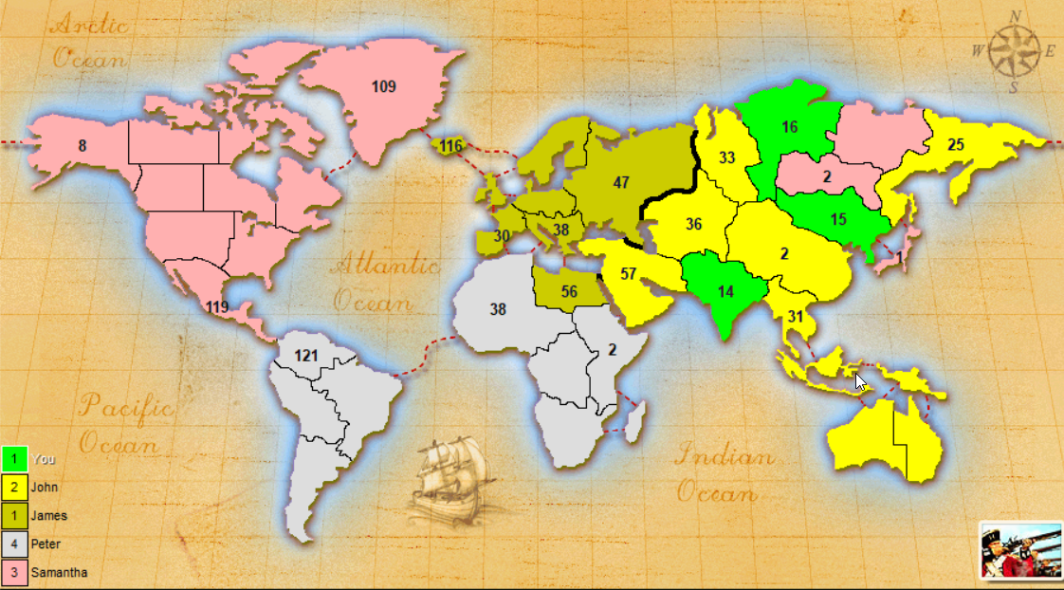
Algorithm Of The Game
Start up:
Number of players are determined (TA: just 5)
All countries are randomly assigned to players
Question: suppose we have 14 countries and 5 players.
How many countries should be assigned to a player?

Slide 6
Algorithm Of The Game
Reinforcement:
The player given a number of armies (= #countries/3)
IF all countries of a continent belong to a player
Receive some armies according to the continent control value
IF he has 3 cards (different or same)
He can exchange cards for armies
In any reinforcement step: for first 3 cards : 5 armies
for second 3 cards 10 armies ….
Minimal number of reinforcement armies is 3
He must at least exchange 3 cards if he has 5 cards or more
Place any armies on any countries he owns
Question: what is the application of “type of cards”?
Question: what does it mean?

Slide 7
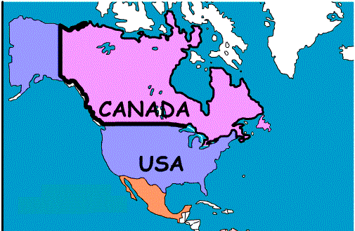
Algorithm Of The Game
Attack:
Choose one of his countries which has at least 2 armies
Declare attack on adjacent countries of opponents
Battle
IF all of the defender armies eliminated the attacker captures the country
After attack modifying the:
Owner of countries
Rewards and cards
Number of armies
After conquer he should place some
armies in his new country
(GE number of previous armies)
Question: what happens IF all of the attacker armies eliminated ?

Slide 8
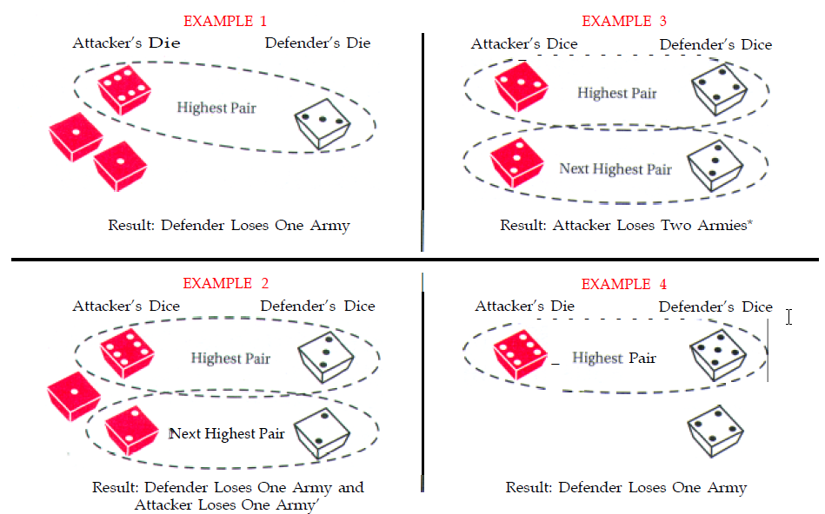
Algorithm Of The Game
Battle :
Attacker 3 dice, Defender 2 dice
Number of dice should be less than number if armies in attacking country
Compare the highest die
Smaller dice loses one army
IF defender rolled 2 dice compare the two next-highest dice
Attacker decide to continue or not

Slide 9
Algorithm Of The Game
After the main 3 phases (Grading):
His turn is finished
IF he has no country Remove
IF he conquer at least one country Receive cards
IF he conquer last country of a player Received all of his cards
IF he captured all of the countries Game finish

Slide 10
Functional Requirements

Slide 11
Functional Requirements
Map editor:
1- User-driven creation of map elements, such as country, continent, and connectivity between countries.
2- Saving a map to a text file exactly as edited (using the “conquest” game map format).
3- Loading a map from an existing “conquest” map file, then editing the map, or create a new map from scratch.
4- Verification of map correctness upon loading and before saving (at least 3 types of incorrect maps).

Slide 12
Functional Requirements
Game Play: Start up phase
1- Game starts by user selection of a user-saved map file.
2- Map is loaded as a connected graph, which is rendered effectively to the user to enable efficient play.
How to represent map?
3- User chooses the number of players, then all countries are randomly assigned to players.
4- Players are allocated a number of initial armies, depending on the number of players.
5- In round-robin fashion, the players place their given armies one by one on their own countries.

Slide 13
Functional Requirements
Game Play: Reinforcement phase
1- Calculation of correct number of reinforcement armies according to the Risk rules.
2- Player place all reinforcement armies on the map.

Slide 14
Functional Requirements
Game Play: Fortification phase
1- Implementation of a valid fortification move according to the Risk rules.

Slide 15
Architectural Design of Project

Slide 16
architectural design of project

